Slide 1
Chapter 14

Slide 2
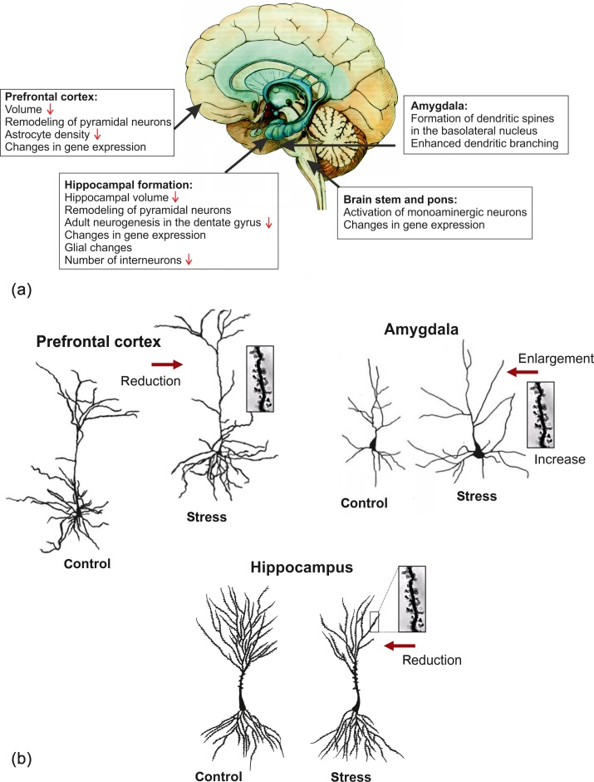
Figure 1 (a) Examples of stress-induced changes in the brain. (b) The stress-induced dendritic remodeling is site specific. Hippocampal formation: remodeling of pyramidal neurons characterized by shrinkage of apical dendrites and loss of spines of pyramidal neurons in region CA3. Medial prefrontal cortex: remodeling of the apical dendritic tree of pyramidal neurons together with the loss of dendritic spines. Amygdala: in the basolateral nucleus, formation of new spines on the dendrites of spiny neurons and increased complexity of the dendritic arbor.

Slide 3
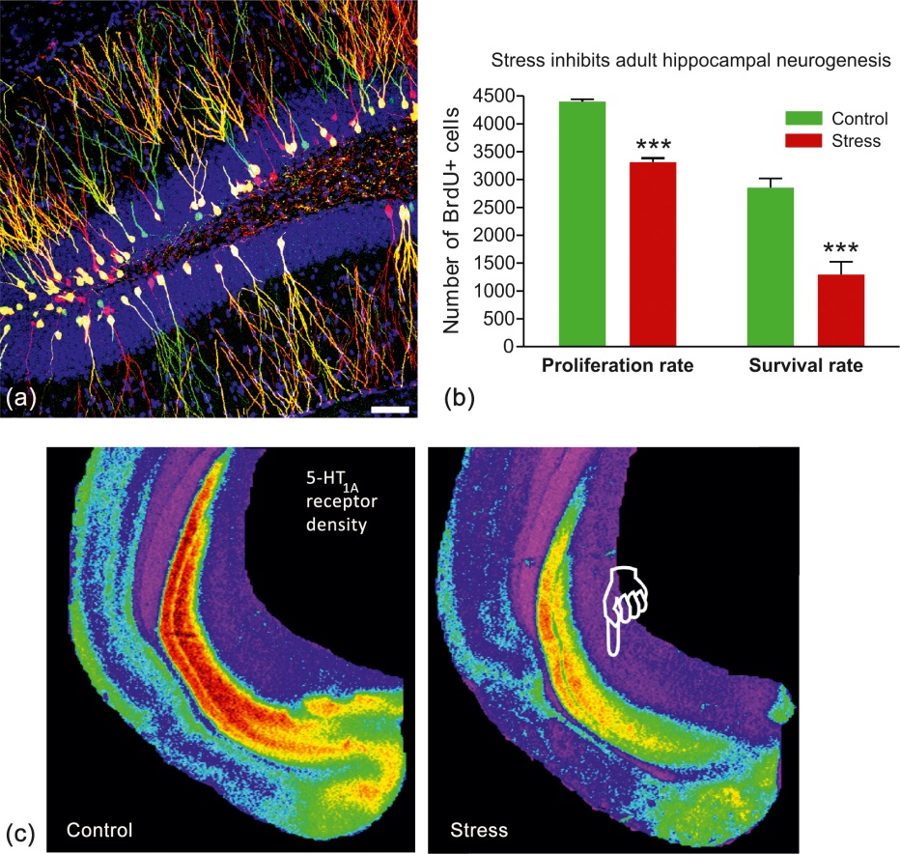
Figure 2 Chronic stress inhibits neurogenesis in the adult hippocampal dentate gyrus and alters serotonergic transmission in the hippocampus. (a) Representative confocal images of newborn neurons in the hippocampus (retroviral labeling). Scale bar 50 μm. (b) Chronic stress inhibits both the proliferation rate and the survival rate of newly generated cells in the hippocampal dentate gyrus. (c) Chronic stress down regulates the density of 5-HT_{1A} receptors in the hippocampus. Male tree shrews were submitted to subordination stress for 28 days, and brain 5-HT_{1A} receptors were quantified by in vitro receptor autoradiography. For details see Ref. 77.

Slide 4
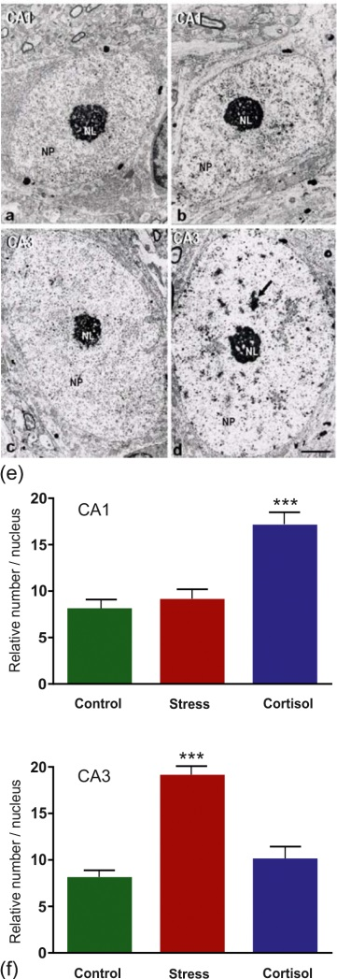
Figure 3 Stress and glucocorticoids affect the formation of heterochromatin in the hippocampus in a site and treatment specific way. Electron micrographs of pyramidal neuron nuclei in the hippocampus of control and stressed male tree shrews: (a) control CA1; (b) stress CA1; (c) control CA3; (d) stress CA3. Note the homogeneous nucleoplasma (NP) in the controls and the large number of heterochromatin clusters (arrow) in nuclei of CA3 pyramidal neurons in stressed animals. NL, nucleolus. Calibration bar: 2 μm. (e–f) Relative number of heterochromatin clusters in electron micrographs from nuclei of pyramidal cells in CA1 and CA3.
With modifications from Ref. 48.

